Slide 1
CP5310
Page Design

Slide 2
Layout Template
Notes:
A <div> is a division tag. It is a generic container which you can add styling and positioning.

Slide 3
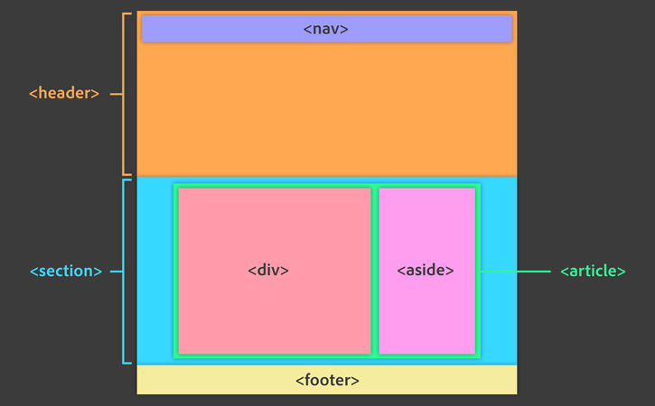
Layout Template with HTML5
https://helpx.adobe.com/dreamweaver/how-to/work-with-html-layout.html?set=dreamweaver--get-started--essential-beginners
Notes:
<div>: Division tag. It is a generic container which you can add styling and positioning.
<header>: Should contain banner image, navigation (or menu) section, and page headings.
<nav>: include the navigation links.
<section>: More specific than <div>. include a group of information related to a specific topic.
<article>: Hold the main content for the topic as well as a quote in a sidebar.
<aside>: Hold the sidebar.
<footer>: holds information such as the copyright, menu navigation, and sitemaps.

Slide 4
Popularity of Screen Resolutions
Date | Other high | 1920x1080 | 1366x768 | 1280x1024 | 1280x800 | 1024x768 | 800x600 | Lower
Jan 2015 | 32.7% | 16% | 33% | 7% | 5% | 4% | 0.3% | 2%
Jan 2014 | 34% | 13% | 31% | 8% | 7% | 6% | 0.5% | 0.5%
Jan 2013 | 36% | 11% | 25% | 10% | 8% | 9% | 0.5% | 0.5%
Jan 2012 | 35% | 8% | 19% | 12% | 11% | 13% | 1% | 1%
Jan 2011 | 50% | 6% |  | 15% | 14% | 14% | 0% | 1%
http://www.w3schools.com/browsers/browsers_display.asp

Slide 5
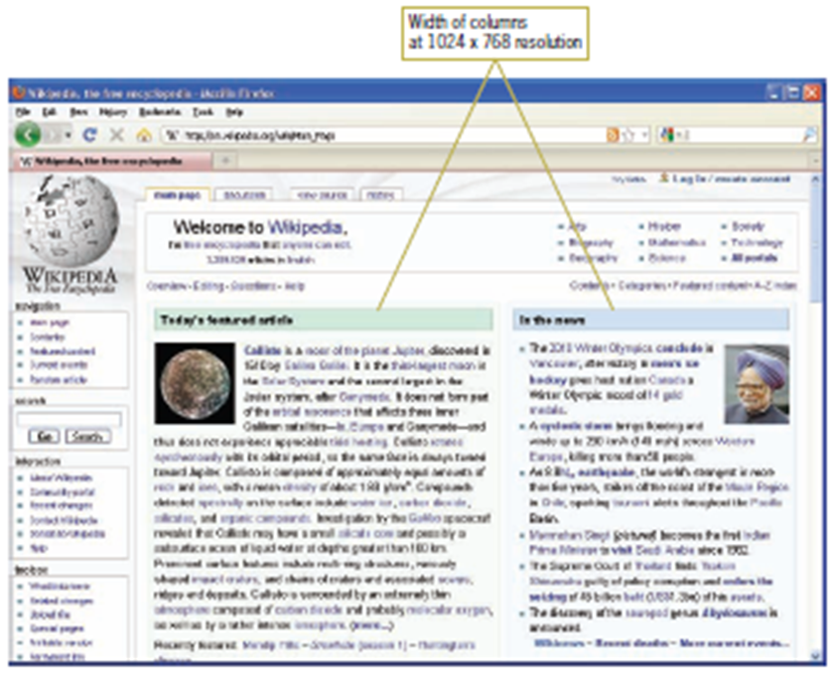
Flexible Page Layouts
Content fills window at 1024 × 768 resolution

Slide 6
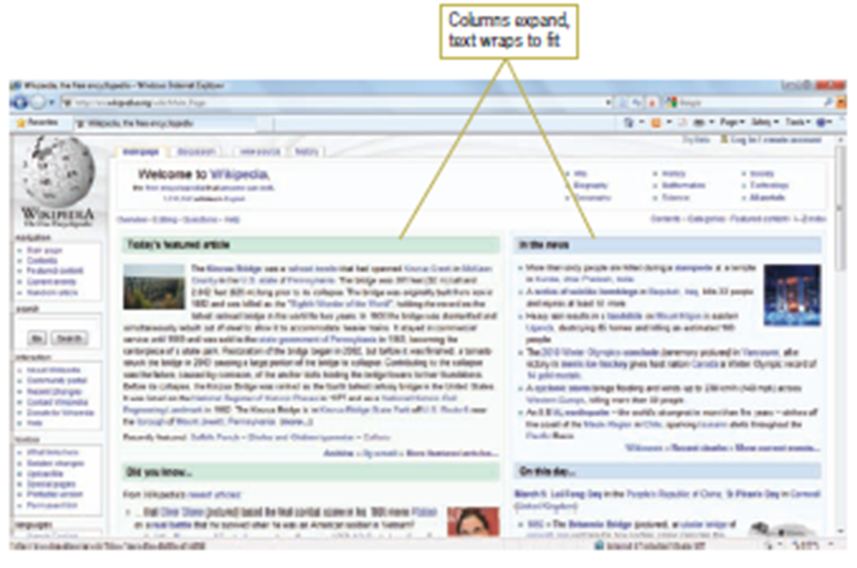
Flexible Page Layouts (cont)
Columns expand to fit at 1366 × 768 resolution

Slide 7
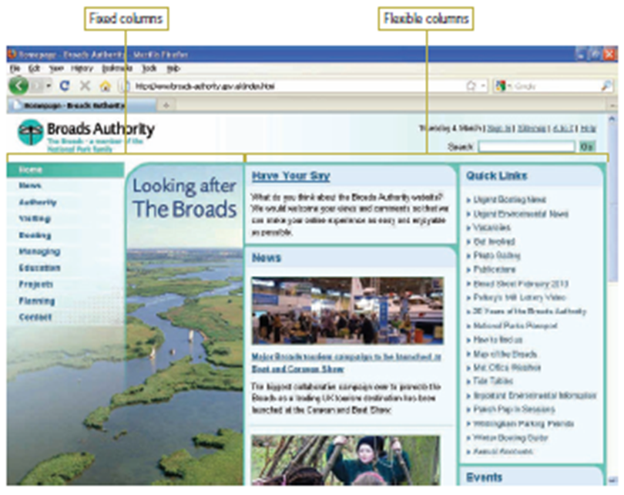
Fixed and Flexible
Broads Authority Web Site at 1024 × 768 resolution

Slide 8
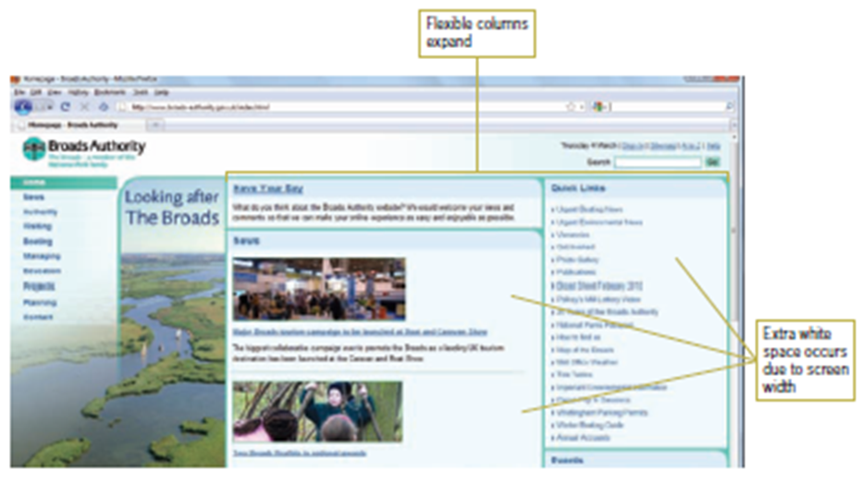
Fixed and Flexible (cont)
Broads Authority Web Site at 1366 × 768 resolution

Slide 9
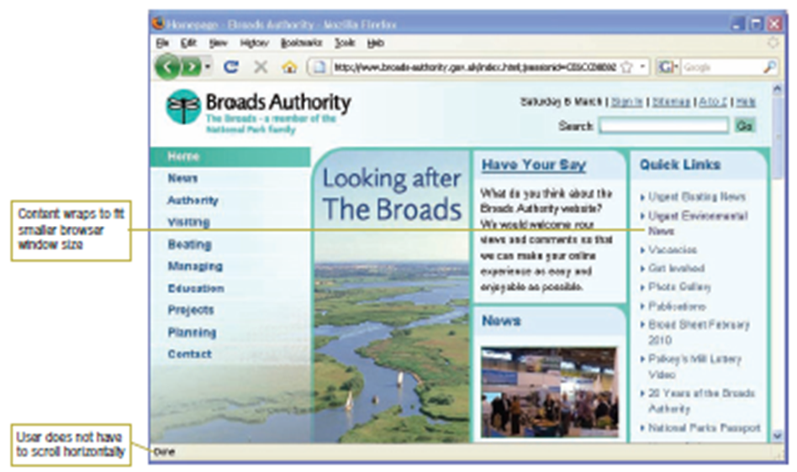
Fixed and Flexible (cont)
Broads Authority Web Site at 800 × 600 resolution

Slide 10
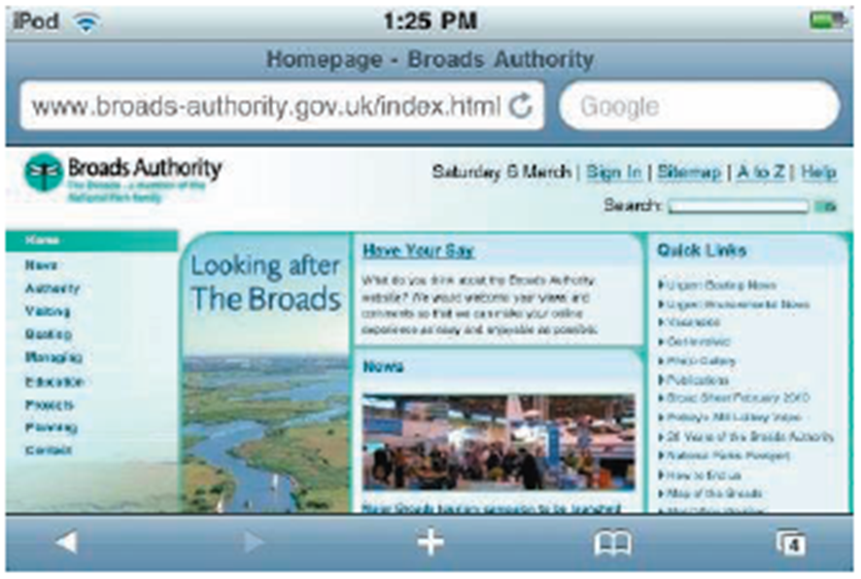
Fixed and Flexible (cont)
Broads Authority Web Site on iPod/iPhone

Slide 11
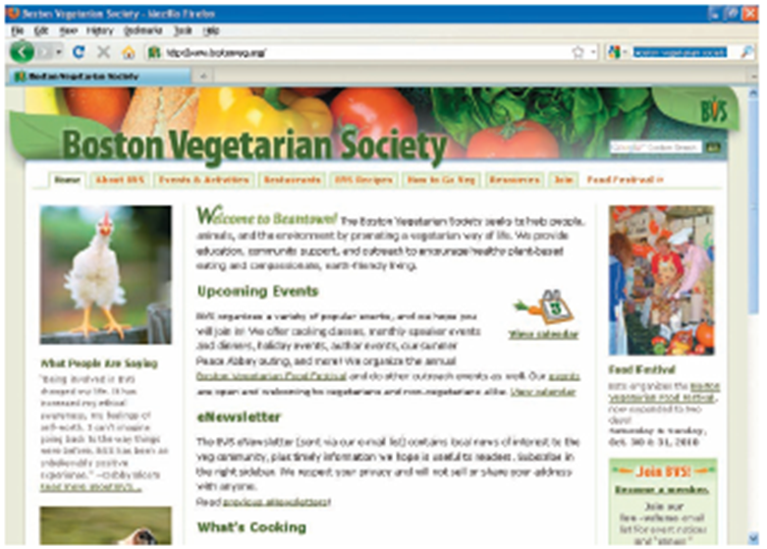
Fixed-Width Page Layout
Fixed-width design at 1024 × 768 resolution

Slide 12
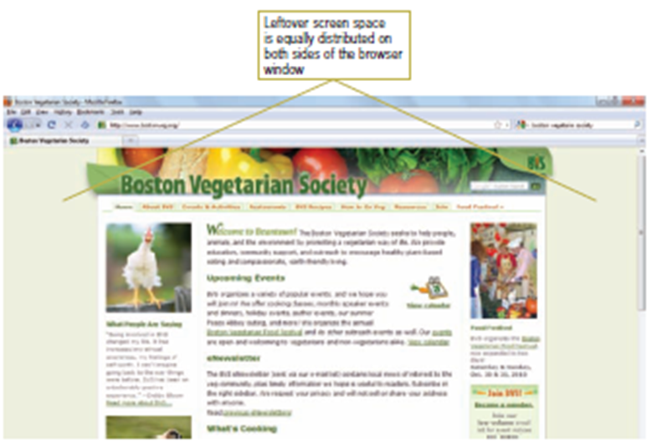
Fixed-Width Page Layout (cont)
Fixed-width design at 1366 × 768 resolution

Slide 13
Fixed or Flexible?
Flexible designs:
User controls the view of the content
Less chance of horizontal scrolling
More flexibility for multiple devices
Better suited to text-based layouts and simpler designs
Fixed-width designs:
Designer controls the view of the content
Allows more complex page layouts
Including fixed-size blocks of content (videos or animations)
More control over text length

Slide 14
Creating a Unified Site Design
Plan smooth transitions
Consistency and repetition from one page to the next
share the same colour scheme, logo, structure, and navigation
Use a grid to provide visual structure
Use active white space wisely

Slide 15
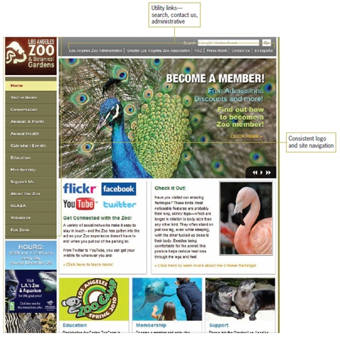
Plan smooth transitions

Slide 16
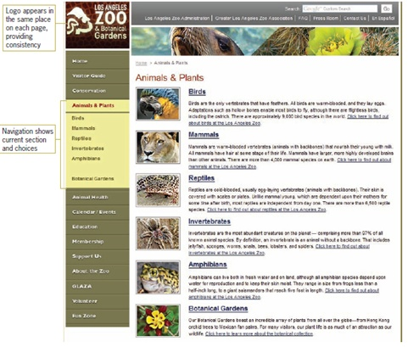
Plan smooth transitions (cont)

Slide 17
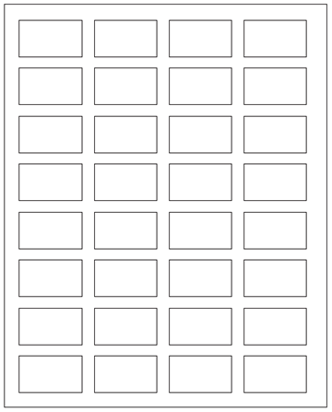
Use a Grid to Provide Visual Structure
Four column grid

Slide 18
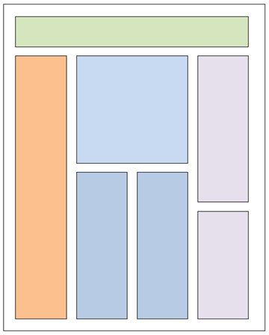
Use a Grid to Provide Visual Structure (cont)
Four column grid with layout elements

Slide 19
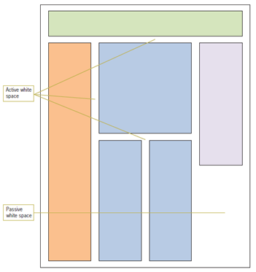
Use Active White Space
Active white space is space that is used deliberately in your design

Slide 20
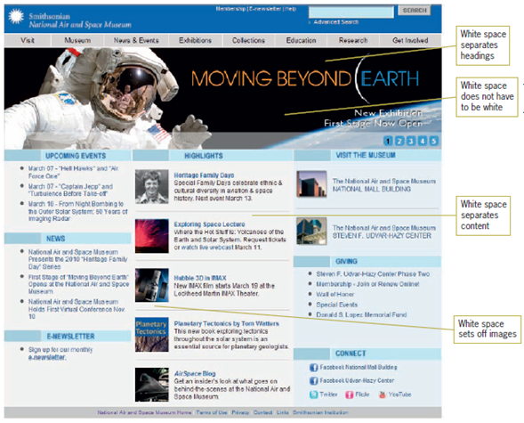
Use Active White Space (cont)
Active white space enhences legibility

Slide 21
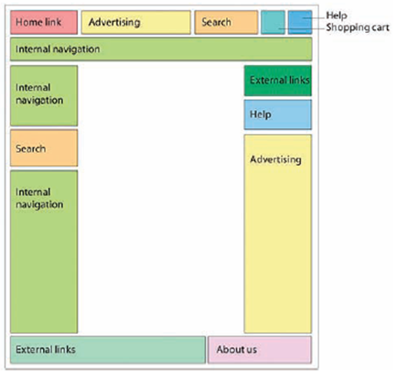
Design for locations

Slide 22
Design for users
3 well-known Veen’s design principles:
Where am I?
Page title
Breadcrumb trail
Highlighted tab
Where can I go?
Search
Global/Local navigation bars
Contextual links
Sitemap or TOC
Help, Index

Slide 23
Design for users (cont)
3 well-known Veen’s design principles:
What is here?
Content should be short and precise
Using headlines to capture the main points
Breaking up pages into clearly defined areas
Contextual links
Meaningful icons or links
Design guidelines for accessibility
Disability
Speak user’s languages
Different browsers etc.

Slide 24
Project First Stage: Planning
Project title
A clear title
For example, BBA web site
The team
Team name and all team members
Goals or Objectives
The mission
For example, to develop a responsive website for The Boys’ Brigade Australia Ltd (BBA) camps to overcome the current standalone or centralised solutions to camp management.
Notes:
• State the project title and objectives of the project
A description of the proposed system in terms of a set of integrated ideas and concepts about what it should do, behave and look like, that will understandable by the users in the manner intended.
• Explain why this project idea is selected
• State what the importance/novelty of this project is

Slide 25
Project First Stage: Planning (cont)
Target Users
Primary users
For example, BBA members want to register for the next camp
Secondary users
For example, a guest want to be a member of BBA
User characteristics
For example,
Age and gender: 12+ males
Education: Secondary school or higher
Computer and web experience: Novice to expert
Notes:
Discuss the characteristics of the target users
Age: Users are likely to be under 25 …
Education
Gender
Computer experience, online shopping experience
…

Slide 26
Project First Stage: Planning (cont)
Features
Identify the basic features to be implemented
For example,
Make BBA and next camp information online.
Enable prospective guests to register as BBA members.
Enable a member to register as a camper.
Enable individuals to update their member and camper data.
Provide a comprehensive search module for camp administration staff on member and camper information.
Provide a comprehensive report-form module for administration staff based on up-to-date camper information.
Provide a comprehensive content management module for administration staff.

Slide 27
Project First Stage: Planning (cont)
Features
Identify and discuss features to enhance user experience
Consider any of the followings:
Screen, menu, icon, logo design
Usage of colour, font, text, image
Usage of media(sound, animation, movie)
Information architecture and navigation systems
see the lecture week02 cp5310-web navi-online shop.pdf
see Chapter 03-04 http://webstyleguide.com/wsg3/index.html

Slide 28
Project First Stage: Planning (cont)
Technologies
Front end requirements: Tools?, Languages?
Back end requirements: Tools?, Languages?, Database?
List main functions or tasks or pages
A site diagram (or blueprint)
defines the site structure, identifies all pages within the site, and shows the pathways linking each page. Its purpose is to organize the development of the site, and should be easily visible to all members of the team (see Chapter 03 http://webstyleguide.com/wsg3/index.html).

Slide 29
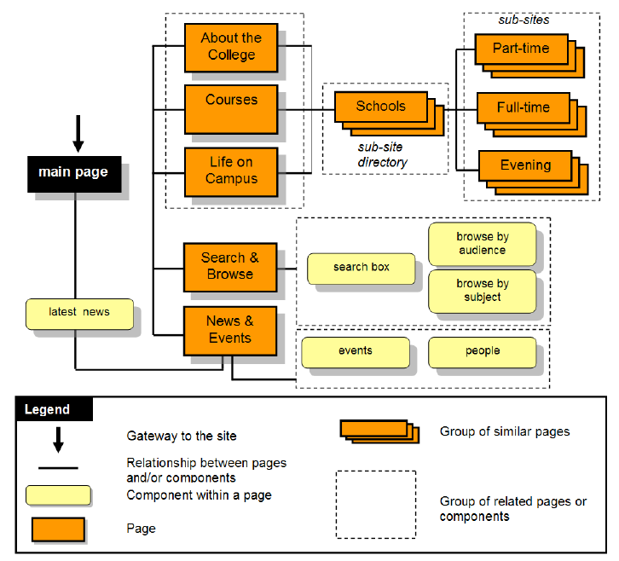
Project First Stage: Planning (cont)
Site diagram (Blueprint)

Slide 30
Project First Stage: Planning (cont)
Technologies
A series of sketched pages (home page and a few subsequent pages). They can even be an abstract visual representation of your site. To be sure that:
Users can easily find what they need (well-structured, meaningful and consistent links)
Users can move around the system easily
Provide feedback that tell users where they are
There is a consistent look throughout the system
Data requirements
For example, user info, product info, order info etc.
ER or class diagram

Slide 31

Project First Stage: Planning (cont)
Abstract visual representation of your site
https://helpx.adobe.com/dreamweaver/how-to/stages-web-design.html?set=dreamweaver--get-started--essential-beginners

Slide 32
Project First Stage: Planning (cont)
Responsibilities
Identify the strengths and weaknesses of each member
State and justify who in charge of what
Schedule
Identify the major milestones of the project
Indicate when each milestone should be achieved

